Slide 1
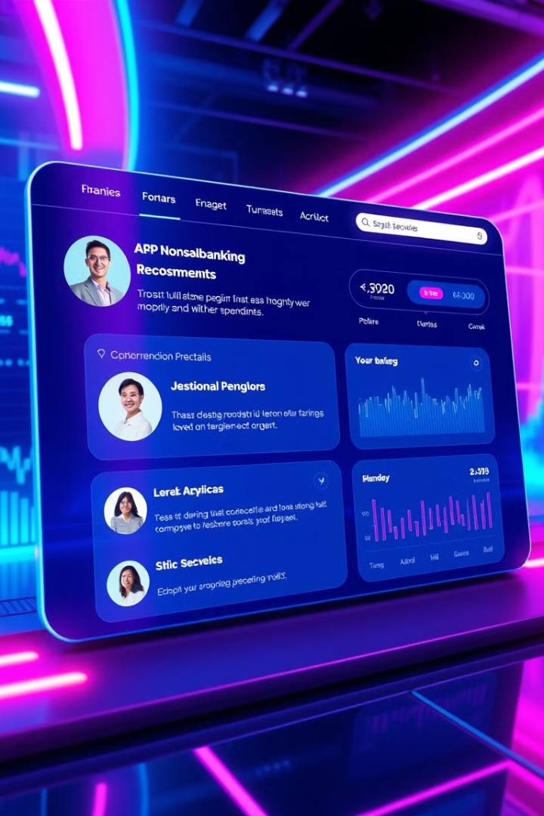
Hyper-Personalization in Banking & Finance
Revolutionizing customer experiences with AI-driven insights. This system leverages AI to provide personalized banking and financial recommendations.
This presentation will cover the objectives, tech stack, and expected results of implementing a hyper-personalization engine.
SR
by SHALYAJ RISHI

Slide 2
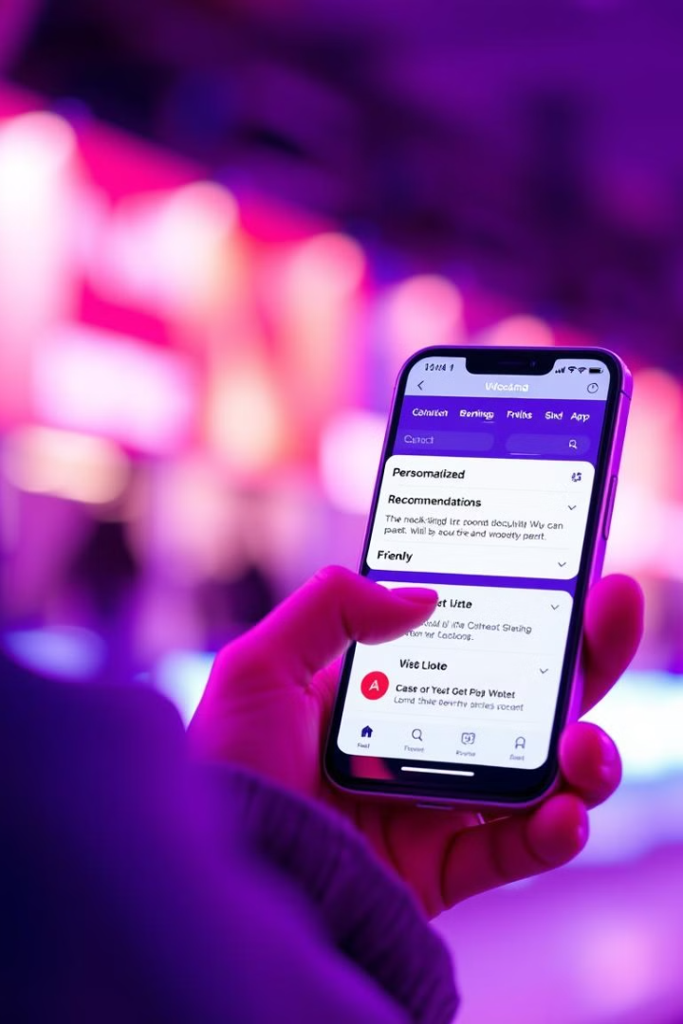
Introduction: The Era of Hyper-Personalization
Customer Expectations
71% expect personalized experiences.
Traditional Methods
Generic offers lead to low conversion rates (2-3% average).
Hyper-Personalization
Tailoring interactions to individual needs in real-time.
Impact
Enhanced loyalty, increased revenue, and improved efficiency.

Slide 3
Project Overview: AI Recommendation System
Objective
Use Case
Deliver hyper-personalized banking and financial recommendations.
User preferences
Transaction history
Key Features
Social media insights
Real-time insights based on user data
Expected Outcome
Proactive suggestions
40% increase in engagement
Automated optimization
25% boost in product adoption

Slide 4
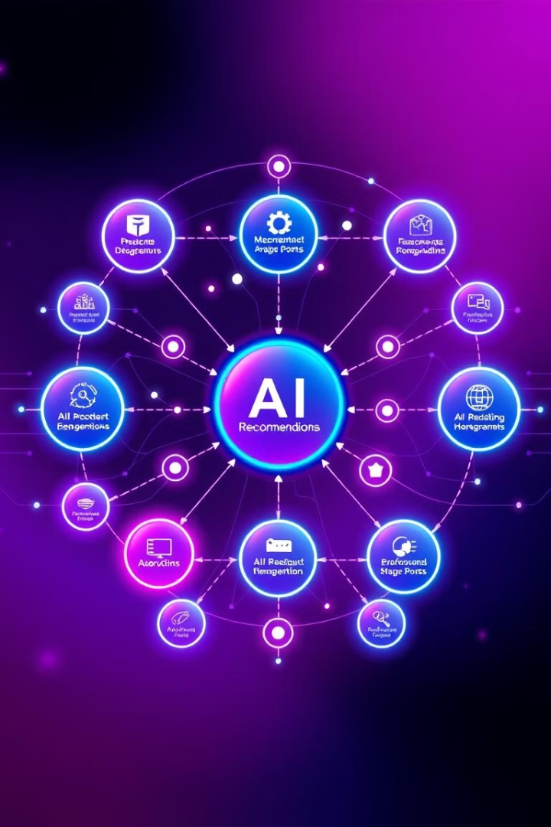



AI-Powered Recommendation Engine: Deep Dive
Collaborative Filtering
Leverages data from similar users. Accounts for 60% of recommendations.
Content-Based Filtering
Analyzes user profiles and product attributes. Drives 30% of recommendations.
AI Component
NLP and ML models for sentiment and predictive analytics. Influences 10%.

Slide 5
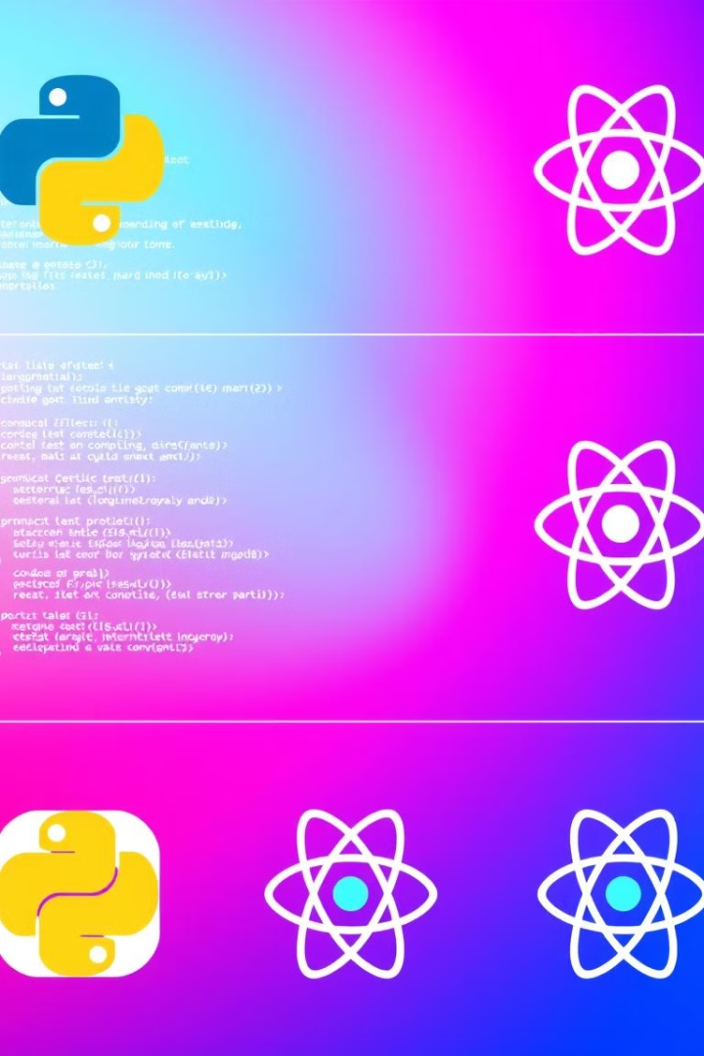



Tech Stack: Powering the Engine
Backend: Python
With LangChain Framework.
AI/LLM
LangChain + GenAI API.
Frontend: React
User-friendly interface.
This robust tech stack ensures scalability, accuracy, and a seamless user experience across all devices.

Slide 6
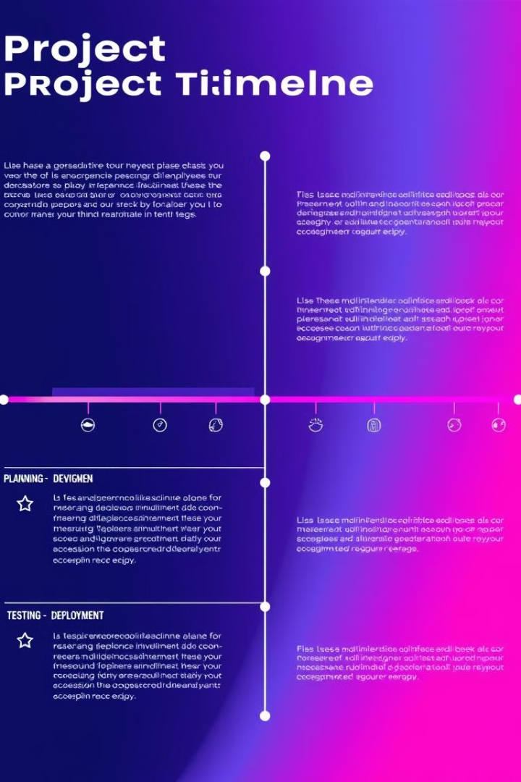
Implementation: A Phased Approach
1
Phase 1: Data Integration
Aggregate data. Train AI models. Establish governance.
2
Phase 2: Pilot Program
Deploy to select users. Gather feedback. Refine models.
3
Phase 3: Full-Scale Deployment
Roll out recommendations. Monitor performance. Implement alerts.
This phased approach ensures a smooth and successful implementation, minimizing risks and maximizing impact.

Slide 7
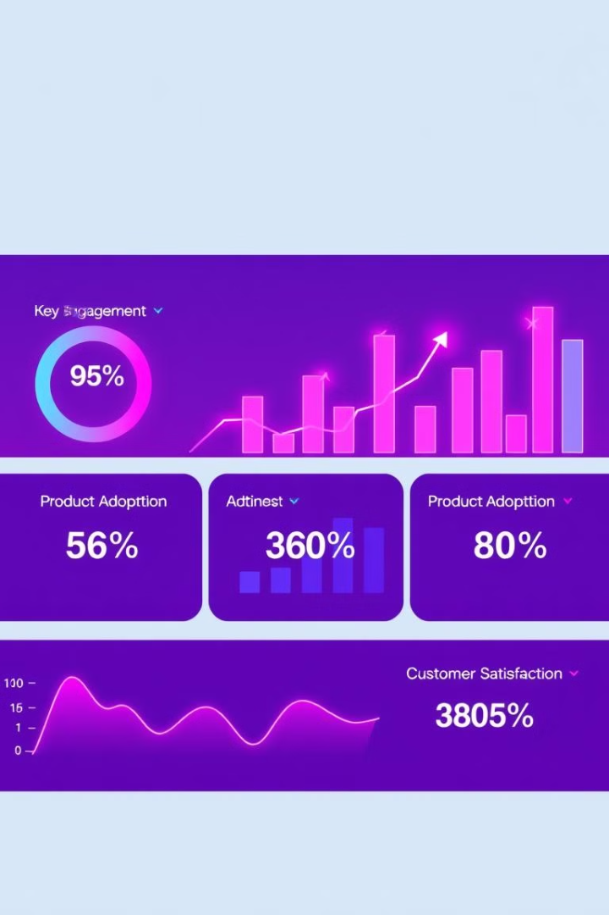
Expected Results & KPIs
40%
Increased Engagement
Uplift in product interactions.
25%
Higher Adoption
Increase in cross-selling.
15
Improved Satisfaction
Net Promoter Score increase.
10%
Reduced Churn
Decrease in customer attrition.

Slide 8
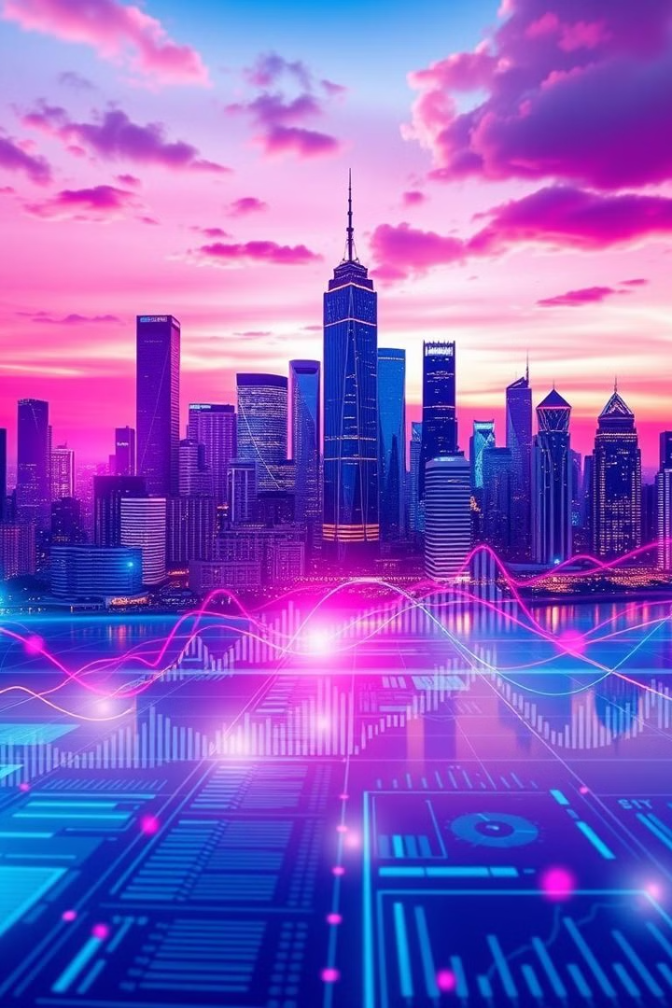
Conclusion: The Future of Banking is Personal
Hyper-personalization
AI-Powered Engines
The key to unlocking customer loyalty and driving revenue growth.
Enable tailored experiences at scale.
Data-Driven Insights
Build stronger customer relationships.

